Slide 1
GTASS
Mark Mcculloh, Trevor Minnix, Omar Mohammed, Kalvin Miller

Slide 2
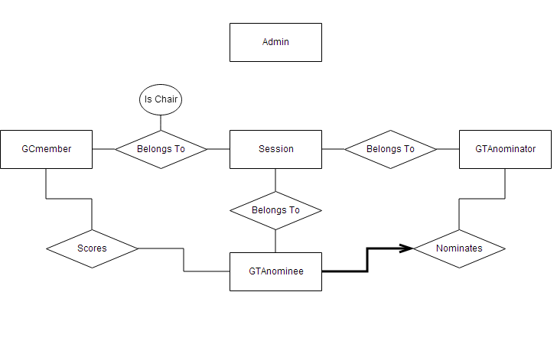
ER Diagram

Slide 3
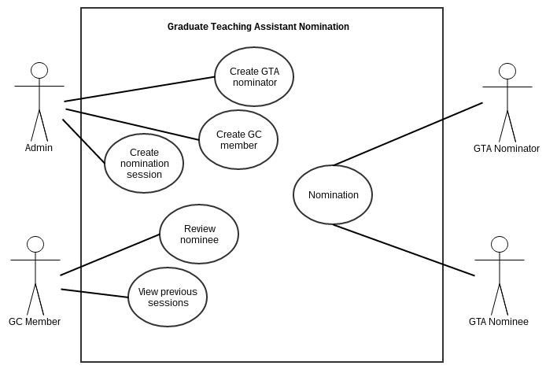
Use-Case Diagram

Slide 4
Development Tools
EasyPHP
MySQL
Apache Server
Javascript
PHP
HTML
CSS

